Slide 1
SKILLANCE
SkillAnce - A Freelance Platform Developed Using MERN Stack

Slide 2
INTRODUCTION
SkillAnce is a freelance website that helps skilled people and clients connect with each other. Just like Fiverr, it allows users to offer and hire services like graphic design, web development, writing, and many more. The platform is easy to use and includes features like secure payments, messaging, and reviews. Skillance makes it simple for freelancers to find work and for clients to get their projects done. The goal is to support online work, create job opportunities, and make freelancing easy and safe for everyone

Slide 3
STATEMENT OF PROBLEM
Finding freelance work and hiring skilled professionals online is often difficult and confusing. Many existing platforms charge high fees, have complex systems, and don’t always support smooth communication between clients and freelancers. New freelancers struggle to get noticed, and clients face challenges in finding the right talent for their projects. There is a need for a simple, affordable, and reliable platform where freelancers and clients can easily connect, work together, and grow.

Slide 4

Difficulty in finding trusted freelancers online
High service fees on existing platforms
Need for a simple and reliable freelance hiring system
Lack of visibility for new or small freelancers
Poor communication between clients and freelancers

Slide 5
OBJECTIVE OF STUDY
The primary objective of this project is to develop and evaluate Skillance, a MERN stack-based freelance service marketplace aimed at simplifying the process of connecting clients with skilled freelancers across various domains, while ensuring secure transactions, real-time communication, and a user-friendly experience for both parties

Slide 6

Develop an Accurate Service Matching System
Enhance Accessibility to Freelance Opportunities
Improve Early Engagement & Client Satisfaction
Optimize Platform Performance and Scalability
Provide Actionable Insights and Reporting Features
Evaluate the Effectiveness of the Skilance Platform
Build a Strong and Trustworthy Community

Slide 7

Gig Marketplace Web App Built with MERN

Slide 8


Slide 9
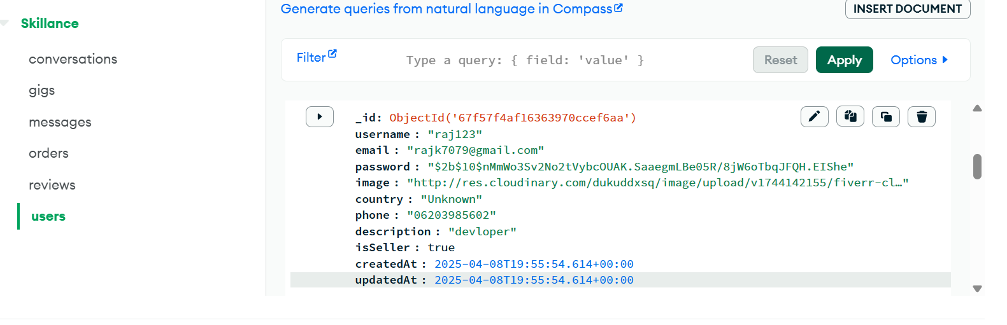
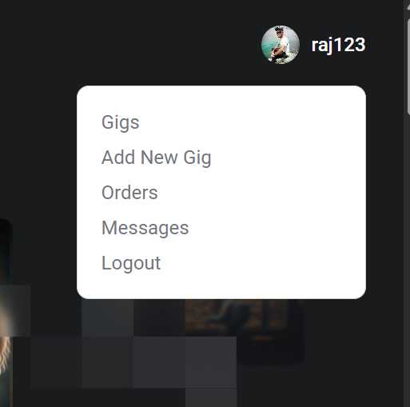
DATASET

Slide 10
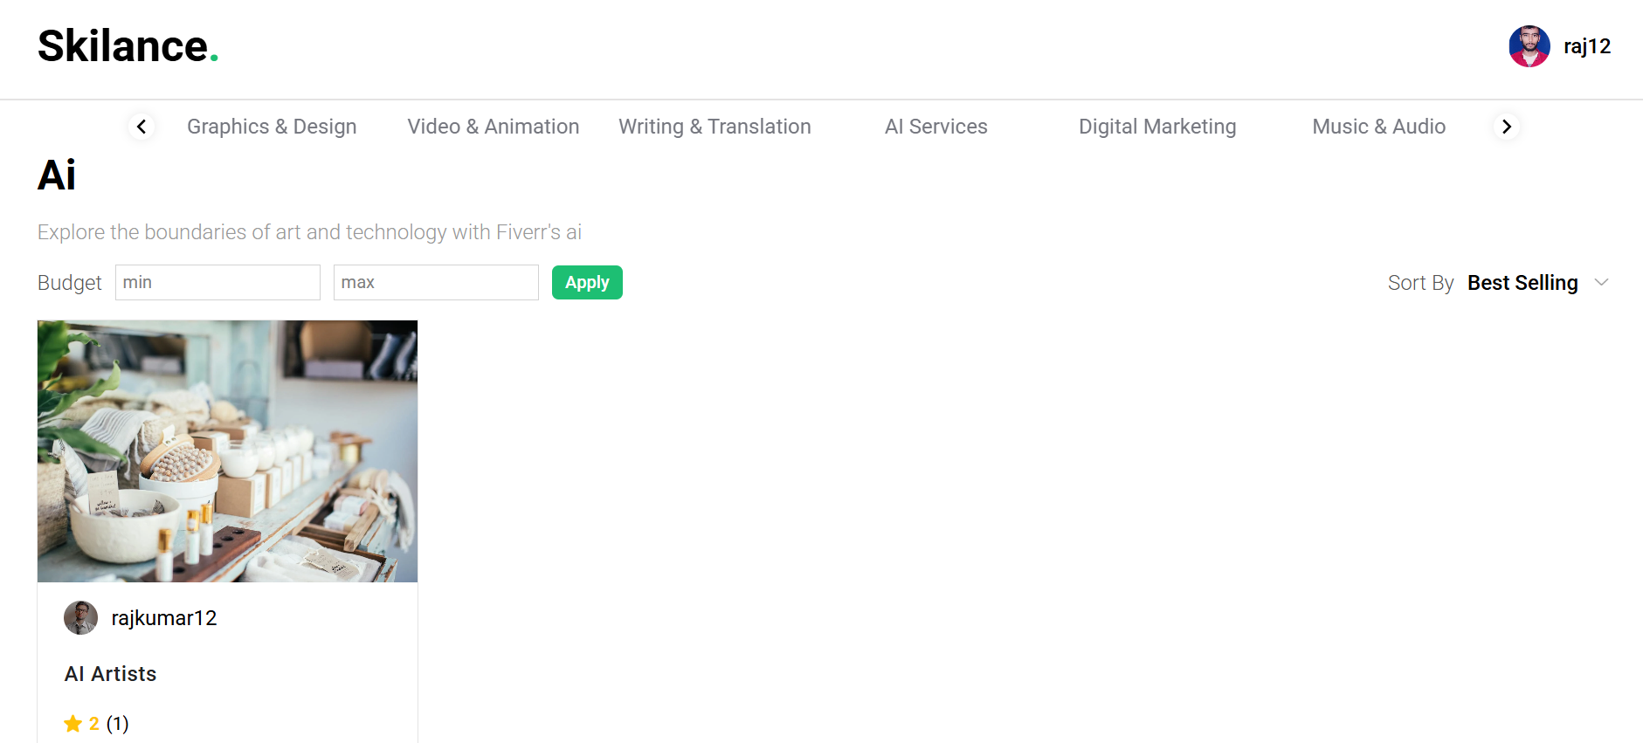
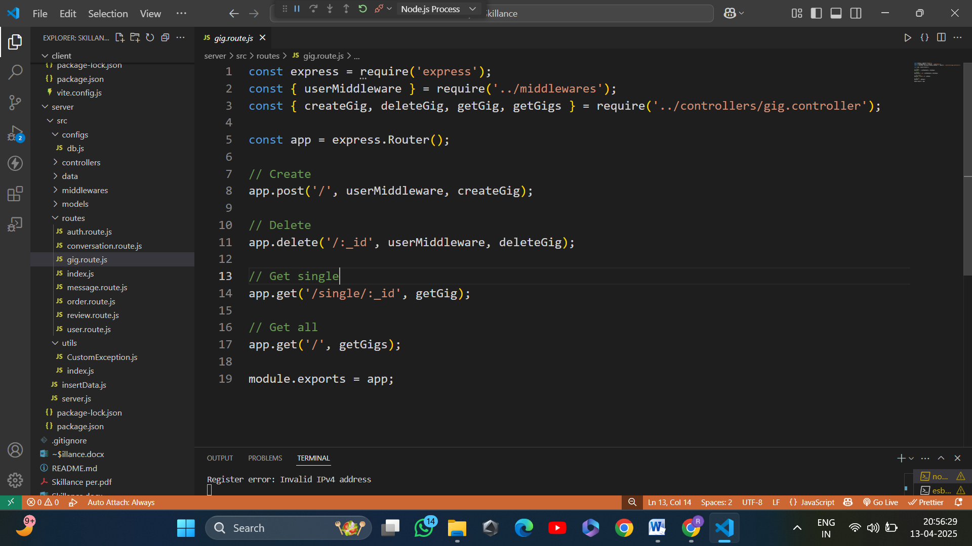
Visual representation of how a user interacts with the platform.

Slide 11
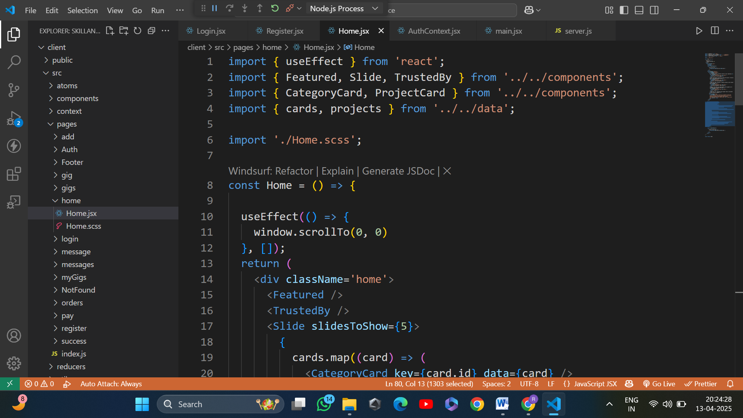
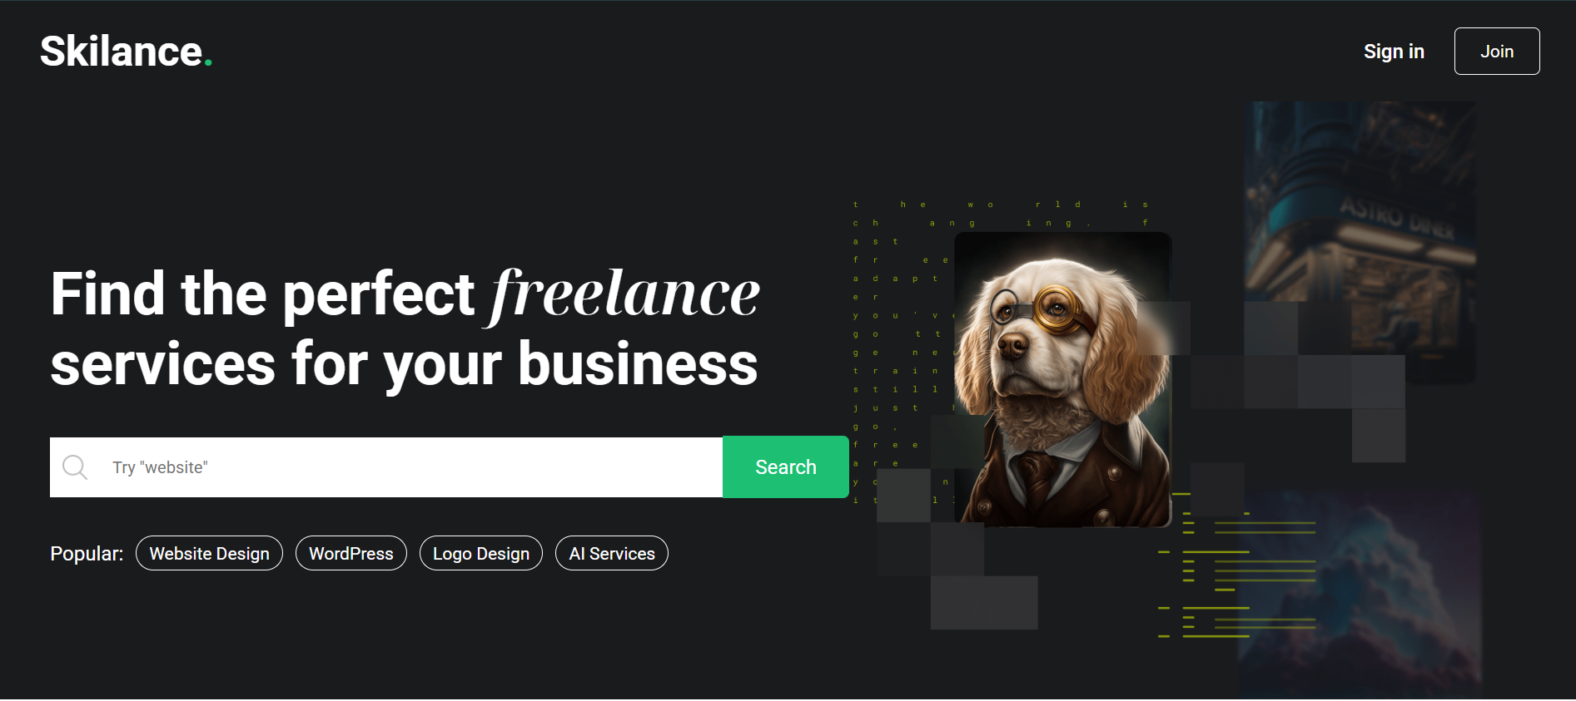

Slide 12
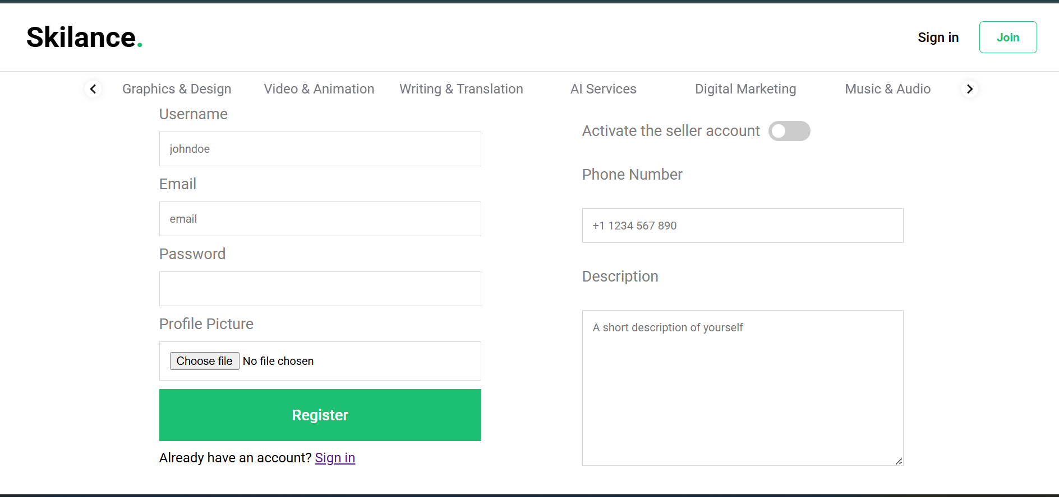
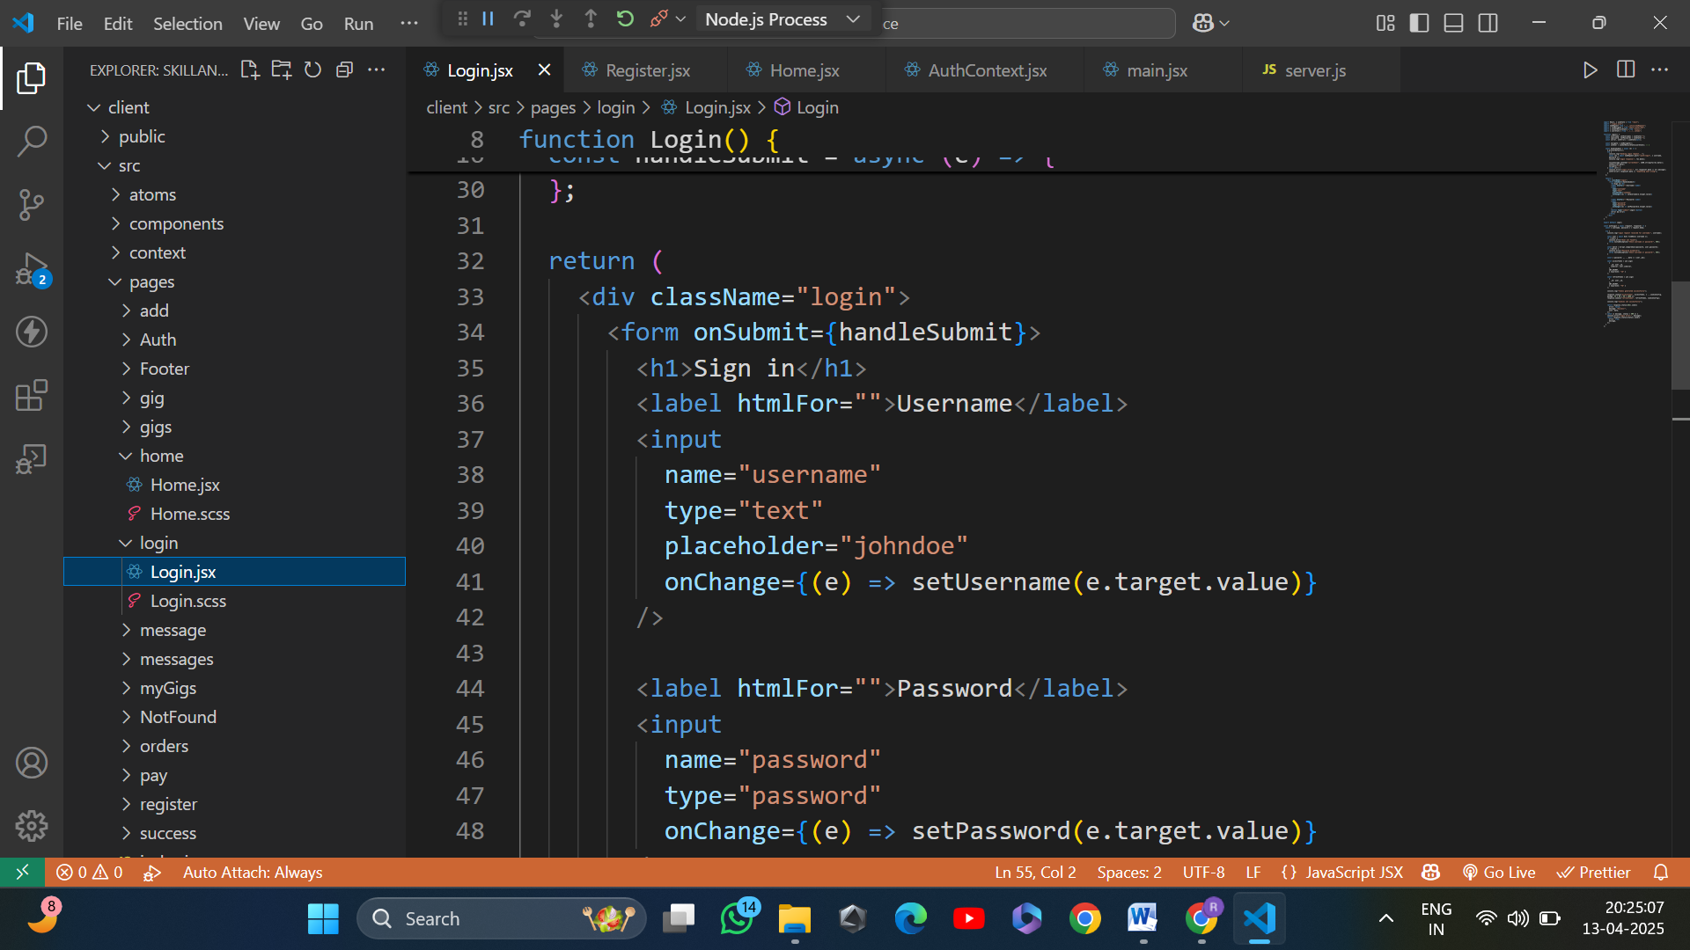

Slide 13
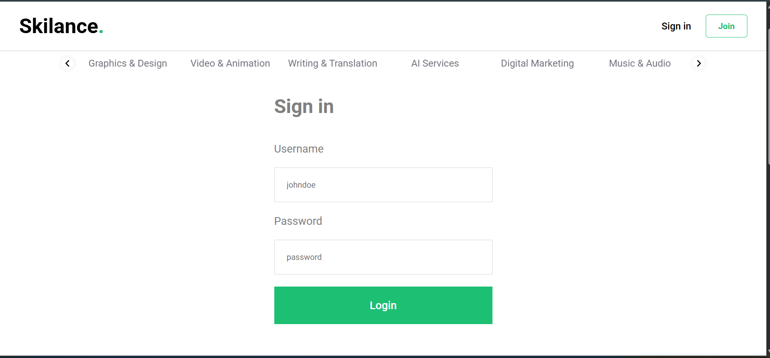

Slide 14
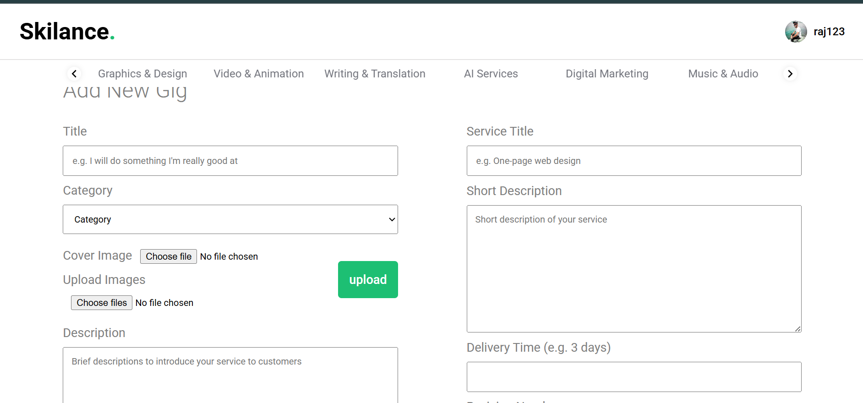

Slide 15
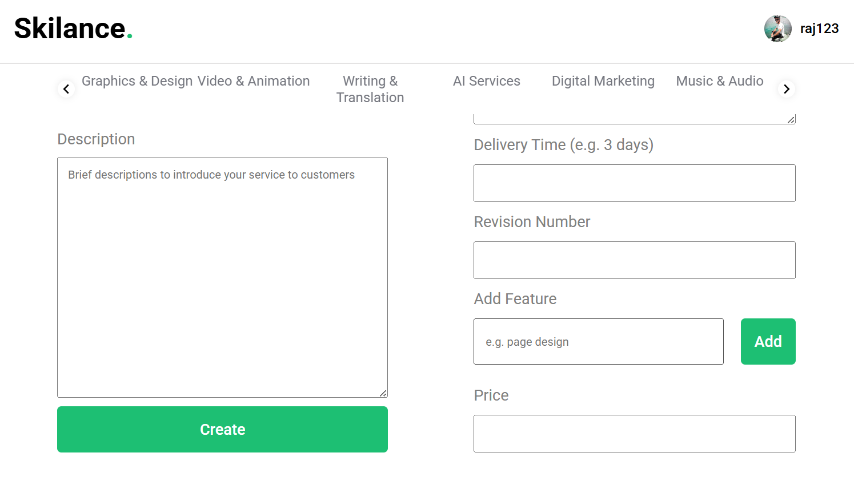

Slide 16
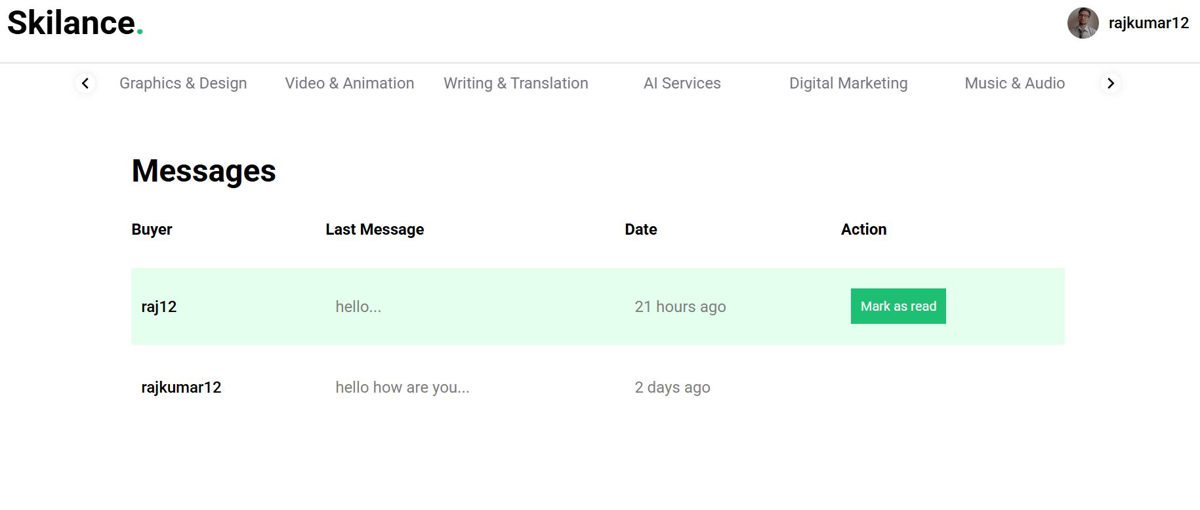

Slide 17
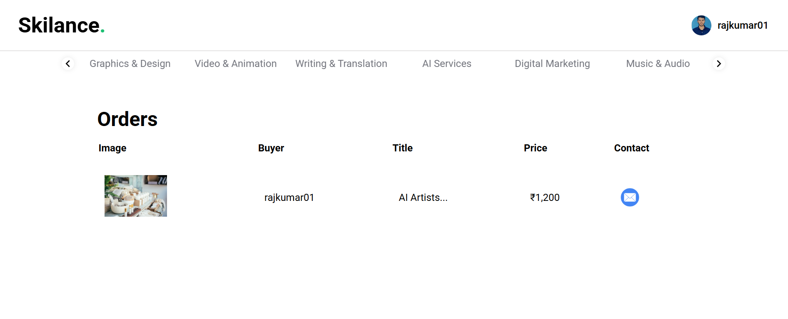

Slide 18
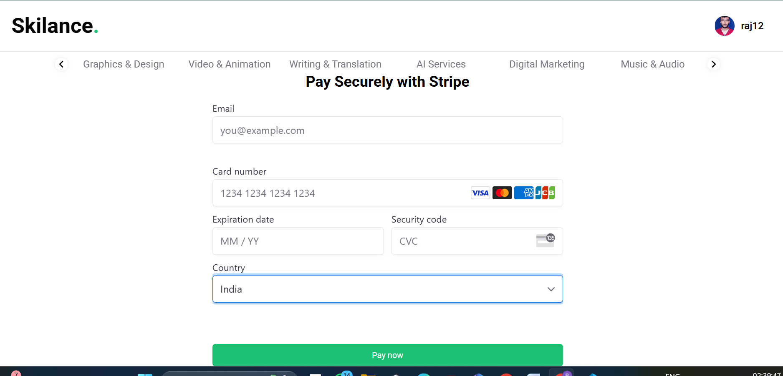

Slide 19
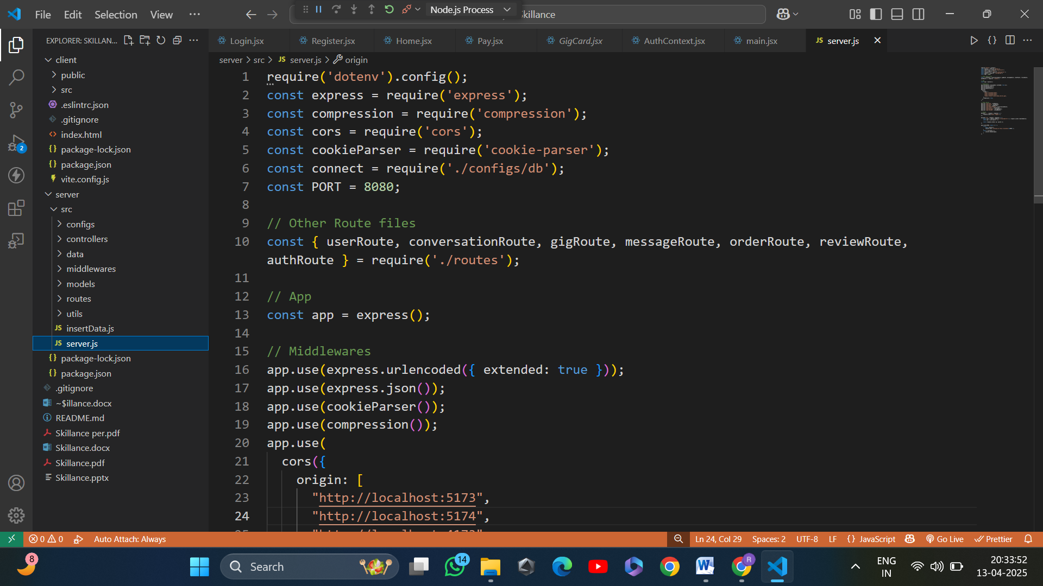
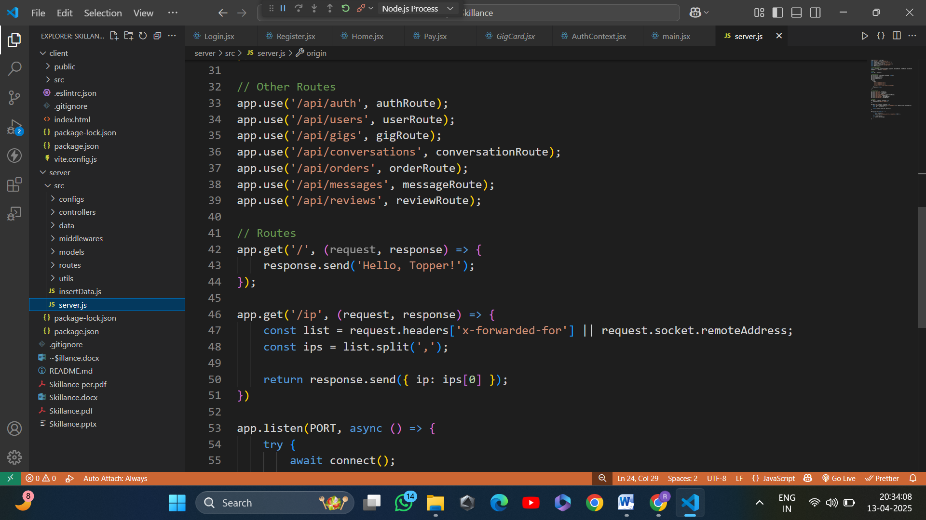
Backend with Express.js

Slide 20
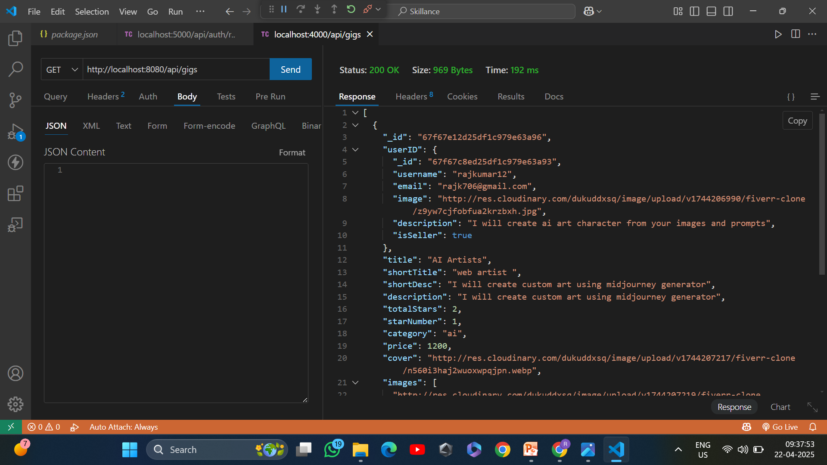
POSTMAN

Slide 21
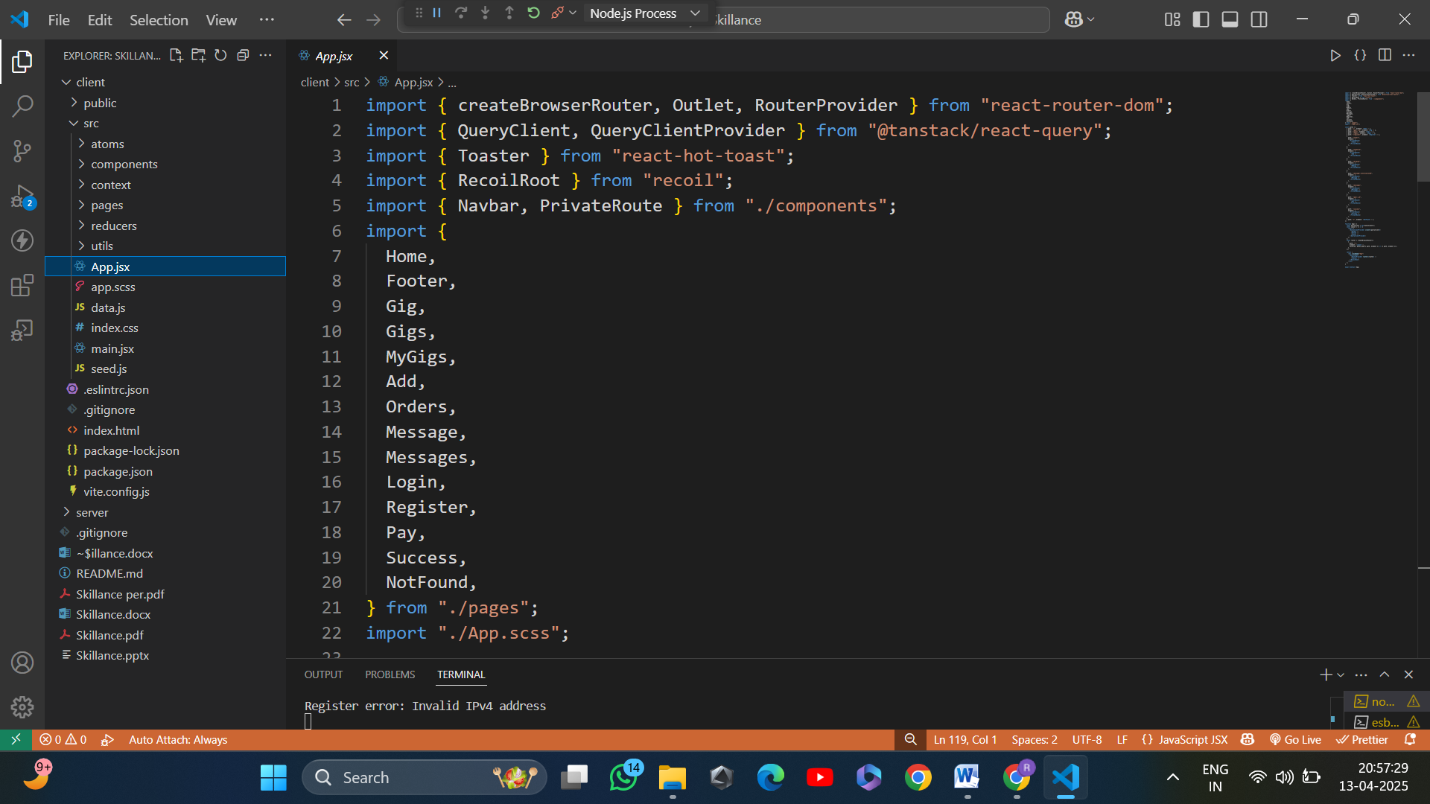
REACTJS

Slide 22
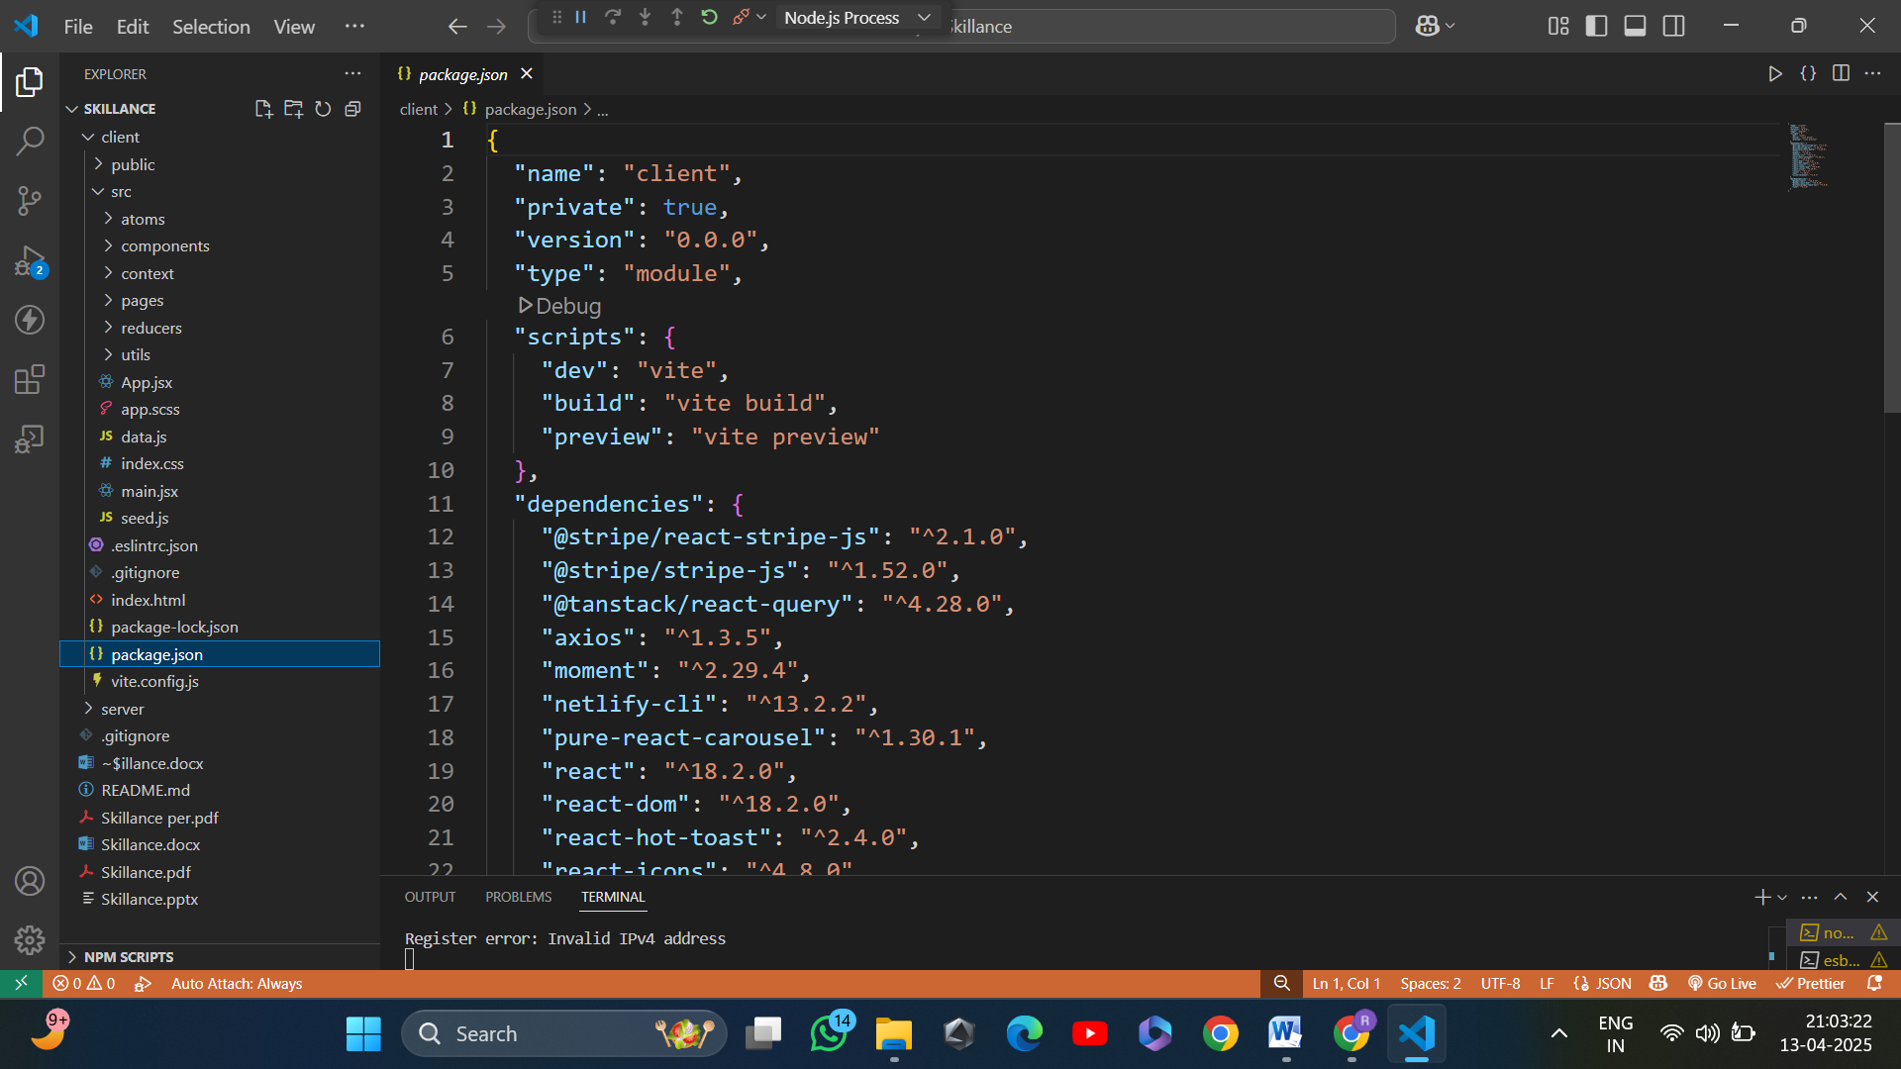

Slide 23
THANK YOU

